Slide 1
XML namespace
XML was designed to be a very robust markup language that could be used in many different applications
When you are creating new elements, there is the chance
that the element's name already exists.
<?xml version="1.0" encoding="ISO-8859-15"?>
<html>
<body>
<p>Welcome to my Health Resource</p>
</body>
<body>
<height>6ft</height>
<weight>155 lbs</weight>
</body> </html>
S. Durga Devi, Assist Prof, CSE, CBIT

Slide 2
Name Conflicts
In XML, element names are defined by the developer. This often results in a conflict when trying to mix XML documents from different XML applications.
This XML carries HTML table information:
<table>
<tr>
<td>Apples</td>
<td>Bananas</td>
</tr>
</table>
2. This XML carries information about a table (a piece of furniture):
<table>
<name>African Coffee Table</name>
<width>80</width>
<length>120</length>
</table>
Both contain a <table> element, but the elements have different content and meaning.
S. Durga Devi, Assist Prof, CSE, CBIT

Slide 3
Solving the Name Conflict
Using a Prefix
Name conflicts in XML can easily be avoided using a name prefix.
1. This XML carries information about an HTML table, and a piece of furniture:
<h:table>
<h:tr>
<h:td>Apples</h:td>
<h:td>Bananas</h:td>
</h:tr>
</h:table>
<f:table>
<f:name>African Coffee Table</f:name>
<f:width>80</f:width>
<f:length>120</f:length>
</f:table>
In the example above, there will be no conflict because the two <table> elements have different names.
S. Durga Devi, Assist Prof, CSE, CBIT

Slide 4
Namespace: Way of keeping the names used by applications separate from each other.
It is collection of elements and attributes names maintained by organization.
Syntax :-
  namespace prefix “name” is a user defined name.
  the value of the xmlns: attribute is a URI, usually belongs to the organization that maintains the namespace.
<name: element_name xmlns :name = “URI” >
S. Durga Devi, Assist Prof, CSE, CBIT

Slide 5
<root>
<h:table xmlns:h="http://www.w3.org/TR/html4/">
<h:tr>
<h:td>Apples</h:td>
<h:td>Bananas</h:td>
</h:tr>
</h:table>
<f:table xmlns:f="http://www.w3schools.com/furniture">
<f:name>African Coffee Table</f:name>
<f:width>80</f:width>
<f:length>120</f:length>
</f:table>
</root>
In the example above, the xmlns attribute in the <table> tag give the h: and f: prefixes a qualified namespace.
When a namespace is defined for an element, all child elements with the same prefix are associated with the same namespace.
S. Durga Devi, Assist Prof, CSE, CBIT

Slide 6
Namespaces can be declared in the elements where they are used or in the XML root element:
<root>
<h:table xmlns:h="http://www.cbit.ac.in">
<h:tr>
<h:td>Apples</h:td>
<h:td>Bananas</h:td>
</h:tr>
</h:table>
<f:table xmlns:f="https://www.gmail.com">
<f:name>African Coffee Table</f:name>
<f:width>80</f:width>
<f:length>120</f:length>
</f:table>
</root>
S. Durga Devi, Assist Prof, CSE, CBIT

Slide 7
Disadvantages of DTD
DTD does not follow the XML syntax it requires new syntax.
Namespace does not supported
No data types.
No modularity and no reuse of elements.
No inheritance for elements or attributes
S. Durga Devi, Assist Prof, CSE, CBIT

Slide 8
XSD- XML Schema Definition
1. XML Schema is an XML-based alternative to DTD.
2. An XML schema describes the structure of an XML
document.
3. The XML Schema language is also referred to as XML
Schema Definition (XSD).
S. Durga Devi, Assist Prof, CSE, CBIT

Slide 9
What is an XML Schema?
The purpose of an XML Schema is to define the legal building blocks of an XML
document, just like a DTD.
An XML Schema:
defines elements that can appear in a document
defines attributes that can appear in a document
defines which elements are child elements
defines the order of child elements
defines the number of child elements
defines whether an element is empty or can include text
defines data types for elements and attributes
defines default and fixed values for elements and attributes
S. Durga Devi, Assist Prof, CSE, CBIT

Slide 10
XML Schemas are the Successors of DTDs:
We think that very soon XML Schemas will be used in most Web applications as a replacement for DTDs. Here are some reasons:
1. XML Schemas are extensible to future additions
2. XML Schemas are richer and more powerful than DTDs
3. XML Schemas are written in XML
4. XML Schemas support data types
5. XML Schemas support namespaces
S. Durga Devi, Assist Prof, CSE, CBIT

Slide 11
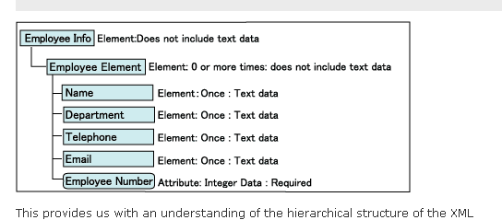
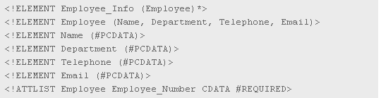
example
DTD file
S. Durga Devi, Assist Prof, CSE, CBIT

Slide 12
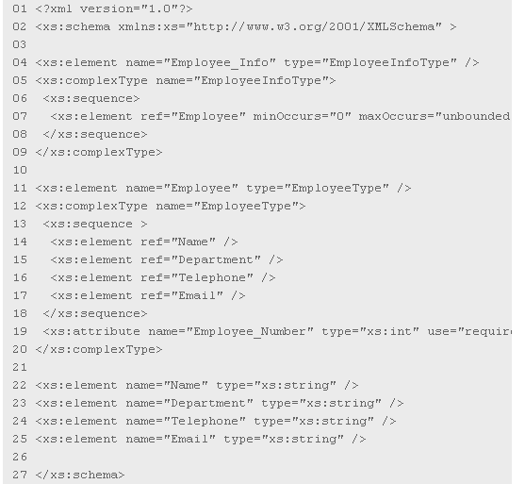
XML scheme- employee.xs
S. Durga Devi, Assist Prof, CSE, CBIT

Slide 13
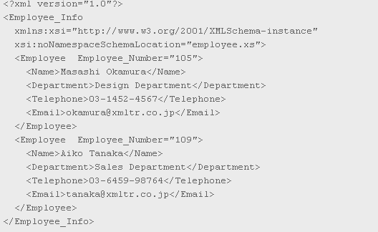
XML document
S. Durga Devi, Assist Prof, CSE, CBIT

Slide 14
XSD structure
XML schema element
<schema> element is used as a root element in XML schema
<?xml version="1.0"?>
<xs:schema>
...
...
</xs:schema>
<?xml version="1.0"?>
<xs:schema xmlns:xs="http://www.w3.org/2001/XMLSchema"
targetNamespace="http://www.cbit.ac.in"
xmlns="http://www.cbit.ac.in"
elementFormDefault="qualified">
...
...
</xs:schema>
S. Durga Devi, Assist Prof, CSE, CBIT

Slide 15
The <schema> element may contain some attributes.
A schema declaration often looks something like this:
<?xml version="1.0"?>
<xs:schema xmlns:xs="http://www.w3.org/2001/XMLSchema"
targetNamespace="http://www.w3schools.com"
xmlns="http://www.w3schools.com"
elementFormDefault="qualified">
...
...
</xs:schema>
xmlns:xs= "http://www.w3.org/2001/XMLSchema"
this elements indicates that the elements and data types used in this XML
schema are come from the "http://www.w3.org/2001/XMLSchema"
targetNamespace="http://www.cbit.ac.in"
elements in this schema comes from "http://www.cbit.ac.in" namespace.
xmlns="http://www.cbit.ac.in" – default namespace
elementFormDefault="qualified"- any element used in this schema
must be namespace qualified.
S. Durga Devi, Assist Prof, CSE, CBIT

Slide 16
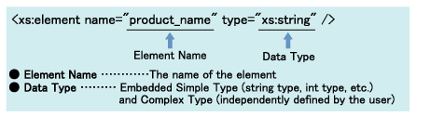
Element declaration
In XSD to declare the elements element is used
There are two types of elements
1. simple element 2. complex element
Simple element- A simple element is an XML element that can contain only text. It cannot contain any other elements( child elements) or attributes
- when no child element the element is designated with attribute name and data type is designated with the type attribute.
syntax
<xs:element name="xxx" type="yyy"/>
<xs:simpleType>……</xs:simpleType>
S. Durga Devi, Assist Prof, CSE, CBIT

Slide 17
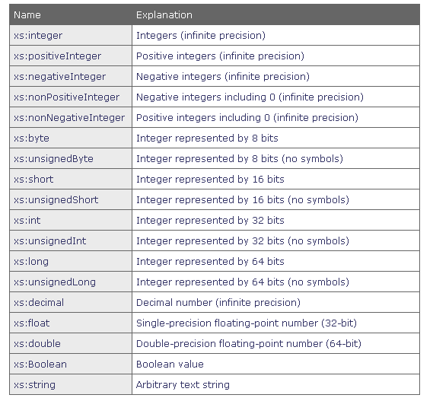
Built in data types in XSD
S. Durga Devi, Assist Prof, CSE, CBIT

Slide 18
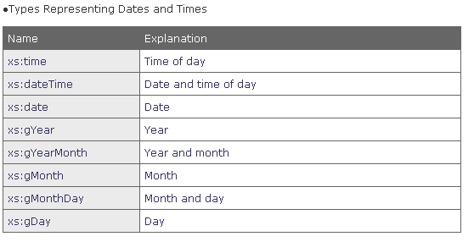
S. Durga Devi, Assist Prof, CSE, CBIT

Slide 19
example
<name>SriRam</name>
<rollno>1101232</rollno>
<age>18</age>
<dob>2010-03-27</dob>
<xs:element name=“name" type="xs:string"/>
<xs:element name=“rollno" type="xs:integer"/>
<xs:element name="age" type="xs:integer"/>
<xs:element name="dateborn" type="xs:date"/>
Default and Fixed Values for Simple Elements
<xs:element name="color" type="xs:string" default="red"/>
<xs:element name="color" type="xs:string" fixed="red"/>
S. Durga Devi, Assist Prof, CSE, CBIT

Slide 20
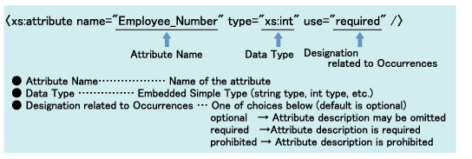
Attribute declaration
All attributes are declared as simple types.
Syntax
<xs:attribute name="xxx" type="yyy"/>
<employee id=“10556">Jamesbond</employee>- XML
<xs:attribute name=“id" type="xs:int"/>-XSD
S. Durga Devi, Assist Prof, CSE, CBIT

Slide 21
Restrictions on Content/ facets
Restrictions are used to define acceptable values for XML elements or attributes. Restrictions on XML elements are called facets.
When u define the data types for elements or attributes, it put restrictions on content of elements and attributes.
If an XML element is of type "xs:date" and contains a string like "Hello World", the element will not validate.
<rollno>1</rollno>- xml
<xs:element name=“rollno">
<xs:simpleType>
<xs:restriction base="xs:integer">
<xs:minInclusive value=“1"/>
<xs:maxInclusive value=“70"/>
</xs:restriction>
</xs:simpleType>
</xs:element>
<xs:element name="car">
<xs:simpleType>
<xs:restriction base="xs:string">
<xs:enumeration value="Audi"/>
<xs:enumeration value="Golf"/>
<xs:enumeration value="BMW"/>
</xs:restriction>
</xs:simpleType>
</xs:element>
S. Durga Devi, Assist Prof, CSE, CBIT

Slide 22
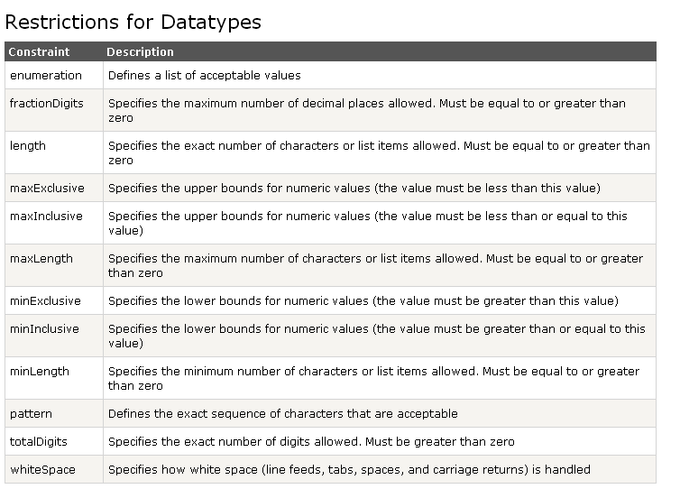
S. Durga Devi, Assist Prof, CSE, CBIT

Slide 23
XSD- Complex elements
A complex element contains other elements and/or attributes.
There are four kinds of complex elements:
1.empty elements with attribures
<employee eid="1345"/>
2.elements that contain only other elements
<employee>
<firstname>John</firstname>
<lastname>Smith</lastname>
</employee>
3. elements that contain s text and attributes
<food type="dessert">Ice cream</food>
4.elements that contain both other elements and text
<description>
It happened on <date lang="norwegian">03.03.99</date> ....
</description>
Note: Each of these elements may contain attributes as well!
S. Durga Devi, Assist Prof, CSE, CBIT

Slide 24
How to Define a Complex Element
Complex elements are defined in following way
<employee>
<firstname>John</firstname>
<lastname>Smith</lastname>
</employee>
The "employee" element can be declared directly by naming the element, like this:
<xs:element name="employee">
<xs:complexType>
<xs:sequence>
<xs:element name="firstname" type="xs:string"/>
<xs:element name="lastname" type="xs:string"/>
</xs:sequence>
</xs:complexType>
</xs:element>
only the "employee" element can use the specified complex type.
<sequence> indicator. This means that the child elements must
appear in the same order as they are declared.
S. Durga Devi, Assist Prof, CSE, CBIT

Slide 25
2. The "employee" element can have a type attribute that refers to
the name of the complex type to use:
<xs:element name="employee" type="personinfo"/>
<xs:complexType name="personinfo">
<xs:sequence>
<xs:element name="firstname" type="xs:string"/>
<xs:element name="lastname" type="xs:string"/>
</xs:sequence>
</xs:complexType>
If you use the method described above, several elements can refer to the
same complex type
<xs:element name="employee" type="personinfo"/>
<xs:element name="student" type="personinfo"/>
<xs:element name="member" type="personinfo"/>
<xs:complexType name="personinfo">
<xs:sequence>
<xs:element name="firstname" type="xs:string"/>
<xs:element name="lastname" type="xs:string"/>
</xs:sequence>
</xs:complexType>
S. Durga Devi, Assist Prof, CSE, CBIT

Slide 26
1.empty elements
<product prodid="1345" />
<xs:element name="product">
<xs:complexType>
<xs:attribute name="prodid“ type="xs:positiveInteger"/>
</xs:complexType>
</xs:element>
S. Durga Devi, Assist Prof, CSE, CBIT

Slide 27
2. Complex Types Containing Elements Only
XML
<person>
<firstname>John</firstname>
<lastname>Smith</lastname>
</person>
XML schema
<xs:element name="person">
<xs:complexType>
<xs:sequence>
<xs:element name="firstname" type="xs:string"/>
<xs:element name="lastname" type="xs:string"/>
</xs:sequence>
</xs:complexType>
</xs:element>
S. Durga Devi, Assist Prof, CSE, CBIT

Slide 28
Complex Text-and attributes Elements it contains simple Content(text/attributes)
you must use simpleContent element around the content.
you must define an extension OR a restriction within the
simpleContent element, like this:
OR
<xs:element name="somename">
<xs:complexType>
<xs:simpleContent>
<xs:restriction base=“datatype">
....
....
</xs:restriction>
</xs:simpleContent>
</xs:complexType>
</xs:element>
<xs:element name="somename">
<xs:complexType>
<xs:simpleContent>
<xs:extension base=“datatype">
....
....
</xs:extension>
</xs:simpleContent>
</xs:complexType>
</xs:element>
S. Durga Devi, Assist Prof, CSE, CBIT

Slide 29
Complex Text-Only Elements it contains simple content(text/attributes)
Example- XML
<carcost Cname=“swift”>600000</carcost>
XML schema
<xs:element name=“carcost">
<xs:complexType>
<xs:simpleContent>
<xs:extension base="xs:integer">
<xs:attribute name=“Cname" type="xs:string" />
</xs:extension>
</xs:simpleContent>
</xs:complexType>
</xs:element>
S. Durga Devi, Assist Prof, CSE, CBIT

Slide 30
Complex Types with Mixed Content
An XML element that contains both text and other elements:
XML
<address>
To,<name>Sree Ram</name>
Flat-no-207<aptname>Aparna</aptname>
<city>hyderabad</city>
</address>
XML schema
<xs:element name=“address">
<xs:complexType mixed="true">
<xs:sequence>
<xs:element name="name" type="xs:string"/>
<xs:element name=“aptname" type="xs:string"/>
<xs:element name=“city" type="xs:string"/>
</xs:sequence>
</xs:complexType>
</xs:element>
S. Durga Devi, Assist Prof, CSE, CBIT

Slide 31
XSD indicators
We can control HOW elements are to be used in documents with indicators.
7 indicators are there
order indicators
1.All 2.Choice 3.Sequence
Occurrence indicators:
maxOccurs
minOccurs
Group indicators:
Group name
attributeGroup name
S. Durga Devi, Assist Prof, CSE, CBIT

Slide 32
order indicators- defines the order of elements
1.All 2.Choice 3.Sequence
All Indicator- child can appear in any order and each child can occur only once.
<xs:element name="person">
<xs:complexType>
<xs:all>
<xs:element name="firstname" type="xs:string"/>
<xs:element name="lastname" type="xs:string"/>
</xs:all>
</xs:complexType>
</xs:element>
S. Durga Devi, Assist Prof, CSE, CBIT

Slide 33
2. Choice Indicator
The <choice> indicator specifies that either one child element or
another can occur:
3. Sequence Indicator
The <sequence> indicator specifies that the child elements
must appear in a specific order:
Occurrence Indicators- define how often an element can occur.
1. <maxOccurs> indicator specifies the maximum number of times an element
can occur:
2. <minOccurs> indicator specifies the minimum number of times an element
can occur:
S. Durga Devi, Assist Prof, CSE, CBIT

Slide 34
Family.xml
Family.xsd
<?xml version="1.0" encoding="ISO-8859-1"?>
<xs:schema xmlns:xs="http://www.w3.org/2001/XMLSchema"
elementFormDefault="qualified">
<xs:element name="persons">
<xs:complexType>
<xs:sequence>
<xs:element name="person" maxOccurs="unbounded">
<xs:complexType>
<xs:sequence>
<xs:element name="full_name" type="xs:string"/>
<xs:element name="child_name" type="xs:string"
minOccurs="0" maxOccurs="5"/>
</xs:sequence>
</xs:complexType>
</xs:element>
</xs:sequence>
</xs:complexType>
</xs:element>
</xs:schema>
<?xml version="1.0" encoding="ISO-8859-1"?>
<persons xmlns:xsi="http://www.w3.org/2001/XMLSchema-instance"
xsi:SchemaLocation="family.xsd">
<person>
<full_name>Hege Refsnes</full_name>
<child_name>Cecilie</child_name>
</person>
<person>
<full_name>Tove Refsnes</full_name>
<child_name>Hege</child_name>
<child_name>Stale</child_name>
<child_name>Jim</child_name>
<child_name>Borge</child_name>
</person>
<person>
<full_name>Stale Refsnes</full_name>
</person>
</persons>
S. Durga Devi, Assist Prof, CSE, CBIT

Slide 35
Group Indicators
Group indicators are used to define related sets of elements.
Element Groups
Element groups are defined with group declaration
<xs:group name="groupname">
...
</xs:group>
You must define an all, choice, or sequence element inside the group declaration.
<xs:group name="persongroup">
<xs:sequence>
<xs:element name="firstname" type="xs:string"/>
<xs:element name="lastname" type="xs:string"/>
<xs:element name="birthday" type="xs:date"/>
</xs:sequence>
</xs:group>
S. Durga Devi, Assist Prof, CSE, CBIT

Slide 36
After you have defined a group, you can reference it in another definition,
like this:
<xs:group name="persongroup">
<xs:sequence>
<xs:element name="firstname" type="xs:string"/>
<xs:element name="lastname" type="xs:string"/>
<xs:element name="birthday" type="xs:date"/>
</xs:sequence>
</xs:group>
<xs:element name="person" type="personinfo"/>
<xs:complexType name="personinfo">
<xs:sequence>
<xs:group ref="persongroup"/>
<xs:element name="country" type="xs:string"/>
</xs:sequence>
</xs:complexType>
S. Durga Devi, Assist Prof, CSE, CBIT

Slide 37
Attribute Groups
<xs:attributeGroup name="groupname">
...
</xs:attributeGroup>
<xs:attributeGroup name="personattrgroup">
<xs:attribute name="firstname" type="xs:string"/>
<xs:attribute name="lastname" type="xs:string"/>
<xs:attribute name="birthday" type="xs:date"/>
</xs:attributeGroup>
Used in other definition also like this
<xs:attributeGroup name="personattrgroup">
<xs:attribute name="firstname" type="xs:string"/>
<xs:attribute name="lastname" type="xs:string"/>
<xs:attribute name="birthday" type="xs:date"/>
</xs:attributeGroup>
<xs:element name="person">
<xs:complexType>
<xs:attributeGroup ref="personattrgroup"/>
</xs:complexType>
</xs:element>
S. Durga Devi, Assist Prof, CSE, CBIT

Slide 38
Presenting XML
XSL stands for extensible stylesheet language used to present XML as HTML.
CSS = Style Sheets for HTML
HTML uses predefined tags, and the meaning of each tag is well understood
Adding styles to HTML elements are simple. Telling a browser to display an element in a special font or color,
XSL = Style Sheets for XML
XSL describes how the XML document should be displayed!
XSL is more than CSS for HTML
It contains
XSLT - a language for transforming XML documents
XPath - a language for navigating in XML documents
XSL-FO - a language for formatting XML documents
S. Durga Devi, Assist Prof, CSE, CBIT

Slide 39
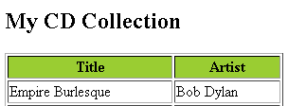
<?xml version="1.0" encoding="ISO-8859-1"?>
<?xml-stylesheet type="text/xsl" href="cdcatalog.xsl"?>
<catalog>
<cd>
<title>Empire Burlesque</title>
<artist>Bob Dylan</artist>
<country>USA</country>
<company>Columbia</company>
<price>10.90</price>
<year>1985</year>
</cd>
.
.
</catalog>
S. Durga Devi, Assist Prof, CSE, CBIT

Slide 40
XSLT- extensible stylesheet language transformation
XSLT is a language for transforming XML documents into XHTML documents or to other XML documents or any other document which could understand by the browser.
Write XML file and write XSL file link to XML file by using following statement in XML file
<?xml version="1.0" encoding="ISO-8859-1"?>
<?xml-stylesheet type="text/xsl" href="cdcatalog.xsl"?>
An XSLT style sheet is an XML document with a root element,
xsl:stylesheet/xsl:transform , which defines namespaces
<xsl:stylesheet version="1.0"
xmlns:xsl="http://www.w3.org/1999/XSL/Transform">
S. Durga Devi, Assist Prof, CSE, CBIT

Slide 41
XSL- style sheet
XSLT <xsl:template> Element
An XSL style sheet consists of one or more set of rules that are called templates.
Template contains rules to apply when the particular node is matched.
The <xsl:template> element is used to build templates.
Content of template element specifies what is to be placed in the output document in HTML
  E.g. to match the root node of the XML doc:
  <xsl:template match = "/"> …
S. Durga Devi, Assist Prof, CSE, CBIT

Slide 42
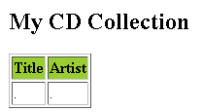
Xml file
<?xml version="1.0" encoding="ISO-8859-1"?>
<catalog>
<cd>
<title>Empire Burlesque</title>
<artist>Bob Dylan</artist>
<country>USA</country>
<company>Columbia</company>
<price>10.90</price>
<year>1985</year>
</cd>
</catalog>
Xsl file
<?xml version="1.0" encoding="ISO-8859-1"?>
<xsl:stylesheet version="1.0"
xmlns:xsl="http://www.w3.org/1999/XSL/Transform">
<xsl:template match="/">
<html>
<body>
<h2>My CD Collection</h2>
<table border="1">
<tr bgcolor=“green">
<th>Title</th>
<th>Artist</th>
</tr>
<tr>
<td>.</td>
<td>.</td>
</tr>
</table>
</body>
</html>
</xsl:template>
</xsl:stylesheet>
S. Durga Devi, Assist Prof, CSE, CBIT

Slide 43
<xsl:value-of> Element
extract the value of an XML element and add it to the output stream
of the transformation:
<?xml version="1.0" encoding="ISO-8859-1"?>
<xsl:stylesheet version="1.0"
xmlns:xsl="http://www.w3.org/1999/XSL/Transform">
<xsl:template match="/">
<html>
<body>
<h2>My CD Collection</h2>
<table border="1">
<tr bgcolor="#9acd32">
<th>Title</th>
<th>Artist</th>
</tr>
<tr>
<td><xsl:value-of select="catalog/cd/title"/></td>
<td><xsl:value-of select="catalog/cd/artist"/></td>
</tr>
</table>
</body> </html>
</xsl:template>
</xsl:stylesheet>
S. Durga Devi, Assist Prof, CSE, CBIT

Slide 44
<xsl:for-each> Element
<xsl:for-each> element can be used to select every XML element of a specified node-set:
<?xml version="1.0" encoding="ISO-8859-1"?>
<xsl:stylesheet version="1.0"
xmlns:xsl="http://www.w3.org/1999/XSL/Transform">
<xsl:template match="/">
<html> <body>
<h2>My CD Collection</h2>
<table border="1">
<tr bgcolor="#9acd32">
<th>Title</th>
<th>Artist</th> </tr>
<xsl:for-each select="catalog/cd">
<tr>
<td><xsl:value-of select="title"/></td>
<td><xsl:value-of select="artist"/></td>
</tr>
</xsl:for-each>
</table> </body> </html>
</xsl:template>
</xsl:stylesheet>
S. Durga Devi, Assist Prof, CSE, CBIT

Slide 45
<xsl:sort> Element
<xsl:sort> - sort the elements
add an <xsl:sort> element inside the <xsl:for-each> element in the XSL file:
example
<xsl:for-each select="catalog/cd">
<xsl:sort select="artist"/>
<tr>
<td><xsl:value-of select="title"/></td>
<td><xsl:value-of select="artist"/></td>
</tr>
</xsl:for-each>
Select element indicates the what element to sort on
S. Durga Devi, Assist Prof, CSE, CBIT

Slide 46
<xsl:if> Element
<xsl:if> Element to put conditions against the context of XML elements
Use this element inside of the <xsl:for-each>
<xsl:if test="expression">
...some output if the expression is true...
</xsl:if>
S. Durga Devi, Assist Prof, CSE, CBIT

Slide 47
<xsl:template match="/">
<html>
<body>
<h2>My CD Collection</h2>
<table border="1">
<tr bgcolor="#9acd32">
<th>Title</th>
<th>Artist</th>
</tr>
<xsl:for-each select="catalog/cd">
<xsl:if test="price &gt; 10">
<tr>
<td><xsl:value-of select="title"/></td>
<td><xsl:value-of select="artist"/></td>
</tr>
</xsl:if>
</xsl:for-each>
</table>
</body>
</html>
</xsl:template>
S. Durga Devi, Assist Prof, CSE, CBIT

Slide 48
<xsl:apply-templates>
The <xsl:apply-templates> element applies a template to the current element or to the current element's child nodes.
If we add a select attribute to the <xsl:apply-templates> element it will process only the child element that matches the value of the attribute
the select attribute to specify the order in which the child nodes are processed.
<xsl:template match="cd">
<p>
<xsl:apply-templates select="title"/>
<xsl:apply-templates select="artist"/>
</p>
S. Durga Devi, Assist Prof, CSE, CBIT

Slide 49
xsl:apply-templates Example
<?xml version="1.0"?>
<xsl:stylesheet version="1.0"
xmlns:xsl="http://www.w3.org/1999/XSL/Transform">
<xsl:template match="name">
<xsl:value-of select="last_name"/>,
<xsl:value-of select=“middle_name"/>,
<xsl:value-of select="first_name"/>
</xsl:template>
<!-- Apply templates only to name children -->
<xsl:template match="person">
<xsl:apply-templates select="name"/>
</xsl:template>
</xsl:stylesheet>
S. Durga Devi, Assist Prof, CSE, CBIT

Slide 50
xsl:choose, xsl:when, xsl:otherwise:
We can also select content using:
<xsl:choose>
<xsl:when test=criteria>
</xsl:when>
<xsl:otherwise>
</xsl:otherwise>
</xsl:choose>
The test attribute works in the same fashion as xsl:if
S. Durga Devi, Assist Prof, CSE, CBIT

Slide 51
<xsl:template match="/">
<html> <body>
<h2>My CD Collection</h2>
<table border="1">
<tr bgcolor="#9acd32">
<th>Title</th>
<th>Artist</th>
</tr>
<xsl:for-each select="catalog/cd">
<tr>
<td><xsl:value-of select="title"/></td>
<xsl:choose>
<xsl:when test="price &gt; 10">
<td bgcolor="#ff00ff">
<xsl:value-of select="artist"/></td>
</xsl:when>
<xsl:otherwise>
<td><xsl:value-of select="artist"/></td>
</xsl:otherwise>
</xsl:choose>
</tr>
</xsl:for-each>
</table>
</body>
</html>
</xsl:template>
S. Durga Devi, Assist Prof, CSE, CBIT

Slide 52
XML processors
Purpose of XML processors
XML processors must check the basic syntax of the document for well- formedness.
Replaces all the references to entities in XML document by their definitions
DTD’s and XML schemas specifies default values these values are copied into XML document during processing.
Parsers included in processors used to validate XML documents against DTD’s and XML schemas.
XML processor makes use of Standard java API
S. Durga Devi, Assist Prof, CSE, CBIT

Slide 53
SAX approach
SAX stands for Simple API for XML
SAX approach processing is called event processing.
This type of processor scans the XML document from the beginning to ending.
Every time a syntactic structure like opening tag, attributes, text and closing tag is recognized, the processor signals event to the application by calling an event handler for the particular structure that was found.
S. Durga Devi, Assist Prof, CSE, CBIT

Slide 54
DOM approach (Document Object Model)
Using this parser API any part of the XML document must be accessed more than once by the application.
Whole document is accessed at a a time
It’s a tree mode.
DOM the entire XML is parsed and a DOM tree is generated & returned.
Reads XML document and creates a way to user applications to use XML.
Disadvantages
- memory inefficient
- slower than SAX.
S. Durga Devi, Assist Prof, CSE, CBIT

Slide 55
references
http://edutechwiki.unige.ch/en/DTD_tutorial#Example_9:_Lone_family_DTD
S. Durga Devi, Assist Prof, CSE, CBIT

